Slide 1

Presentation On College management System(FEC Diary)
Prepared By:
Md Mitul Hossain(09)
Gazi Abul Kalam Azad(27)
Mujahidul Islam(36)
Sakil Ahmed Sobuj(65)
Supervised By:
Md. Rony Ahmed
Lecturer,
Dept. of Computer Science Engineering,
Faridpur Engineering College

Slide 2
FEC DIARY
s
Make Your student life easier

Slide 3
INTRODUCTION
FEC-DIARY is a web application to maintain college management system.
This is a digital solution that helps automate tasks. This project is very helpful for students workflow.
FEC DIARY stores and tracks students’ workload, personal information. It’s a means of streamlining the work and tracking all the data generated by a student, consolidating everything into one system rather than multiple records.
Main Function Of This Module This is a customized module where student’s details are maintained and stored for future. The information can be used when required by the administration.

Slide 4
MOTIVATION & GOAL
Helpful to perform paperless work and manage academic data
Data provides easily and accurately
Faster data access
Getting Valuable necessary announcement
Managing attendance and scheduling other events and assignments.
Descriptive dashboards that makes it easier for faculties to evaluate trends
that determine student’s performances.

Slide 5
APPLICATION FEATURES
Dashboard
Student Login
Admin Login
Teacher Login
Staff Login
Student Details
Teacher Details
Staff Details
Student Profile
Student Register
Academic Calendar
Notice manage

Slide 6
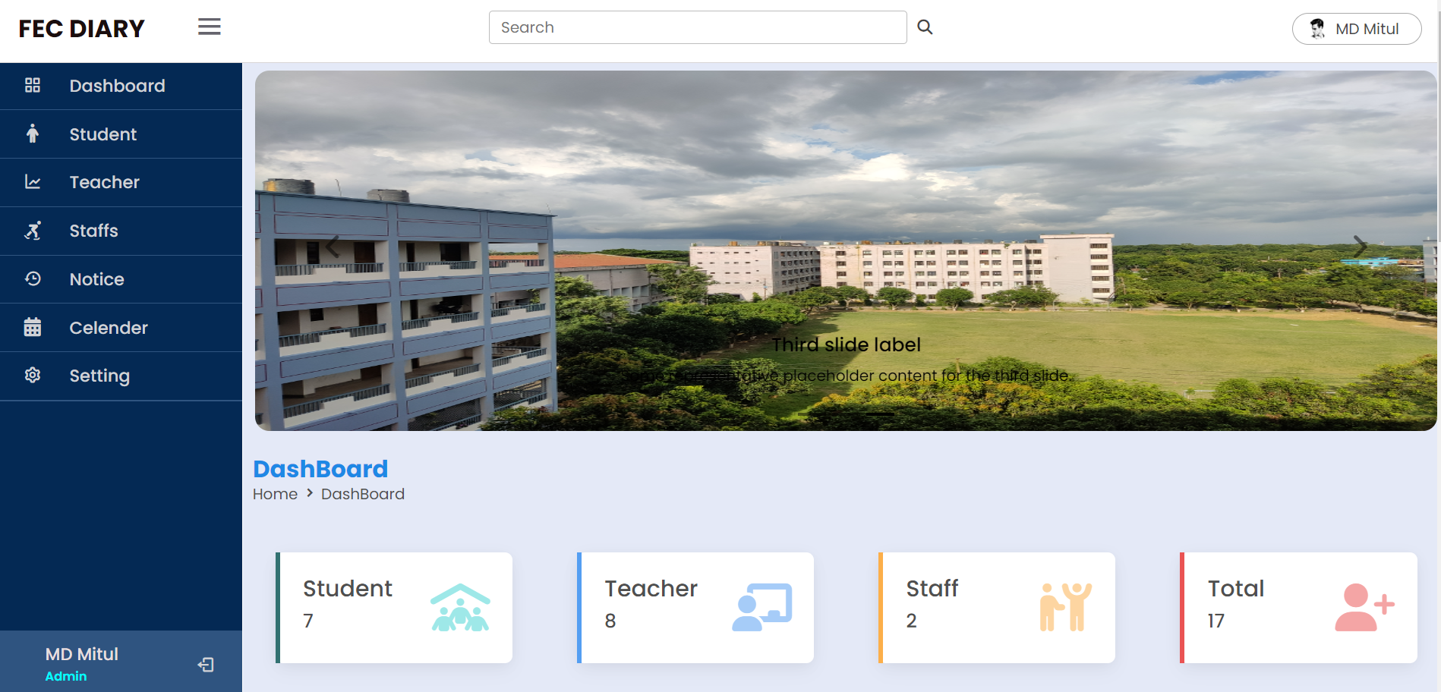
APPLICATION FEATURES(Cont..)
DASHBOARD
The dashboards includes the following:
Students, Teachers, Non-Teaching staff,
Other administrative staff. Dashboard page
will give access to all the various academic
modules Like , login ,sign Up Student
Management , notice ,calendar,
university location etc.

Slide 7
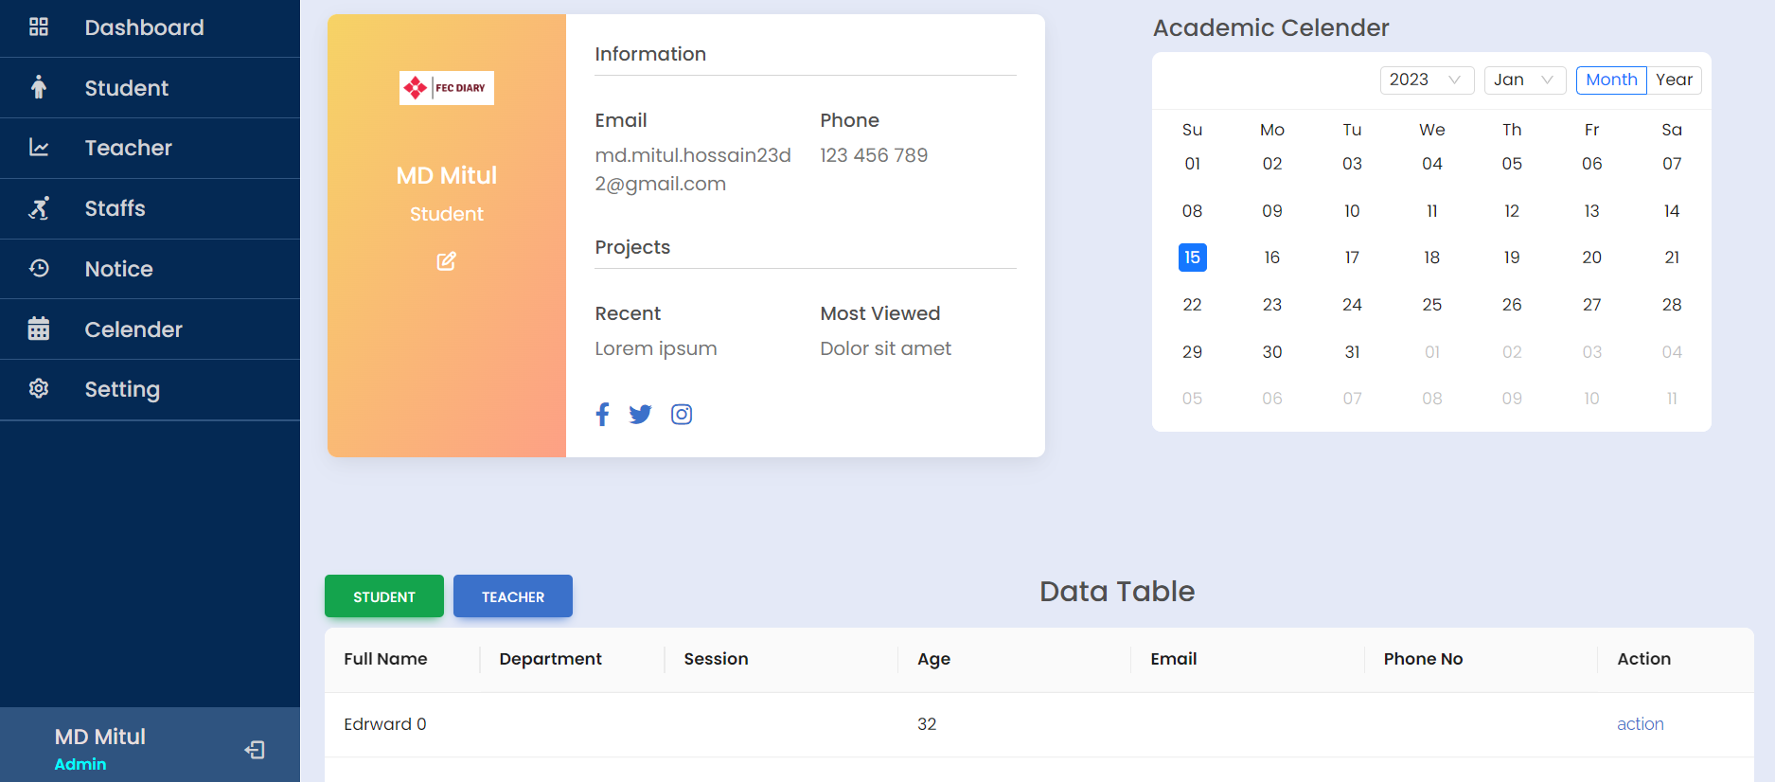
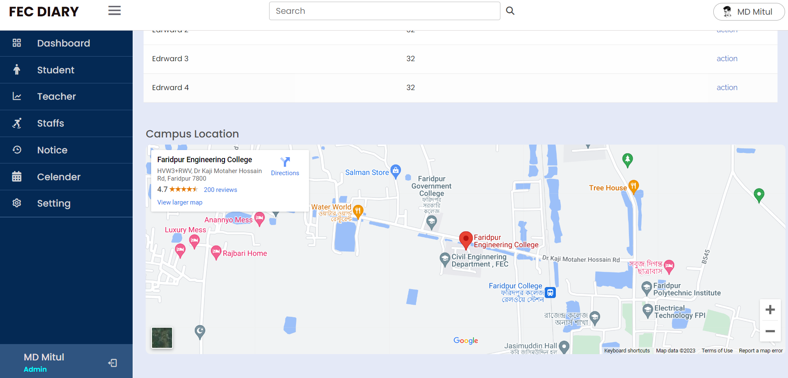
APPLICATION FEATURES(Cont..)
Dashboard

Slide 8
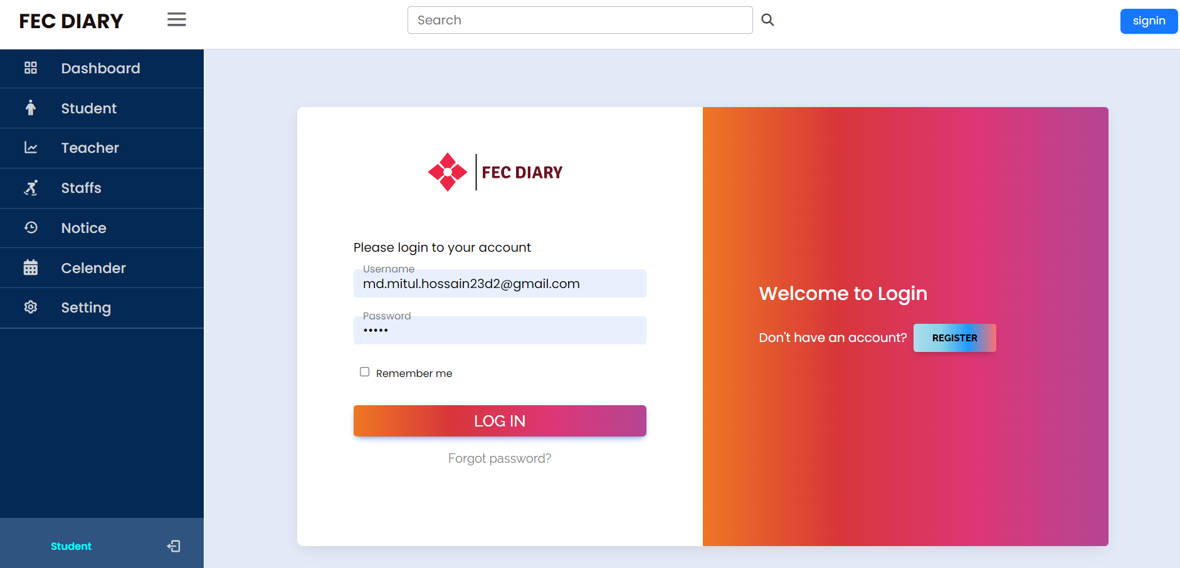
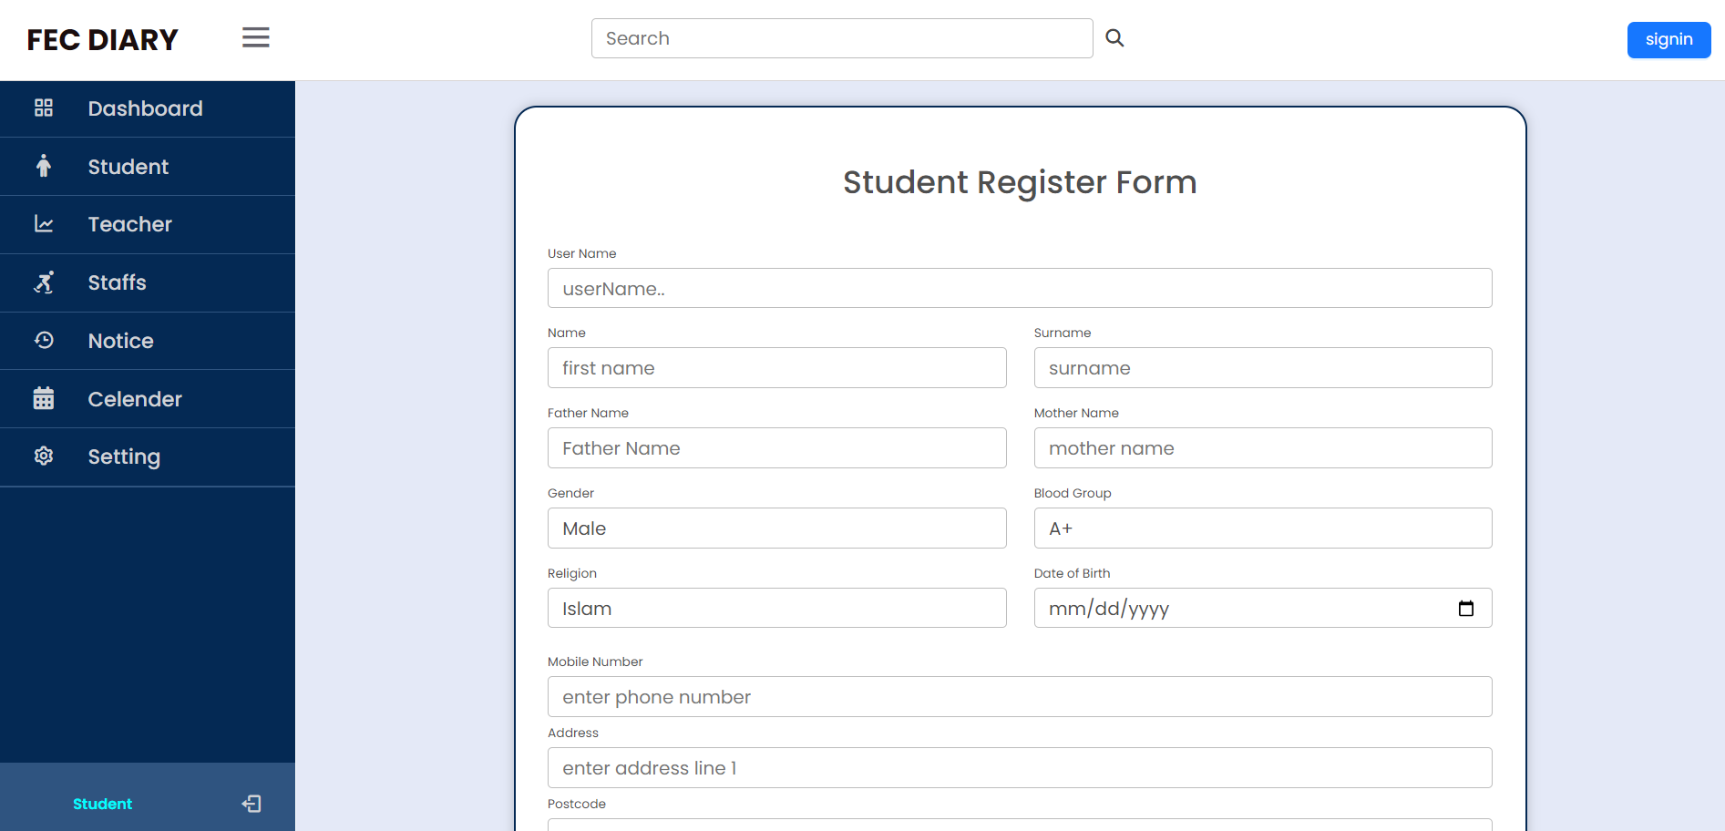
APPLICATION FEATURES(Cont..)
In order to getting access of this application , Student/Admin must be needed to register/login.

Slide 9
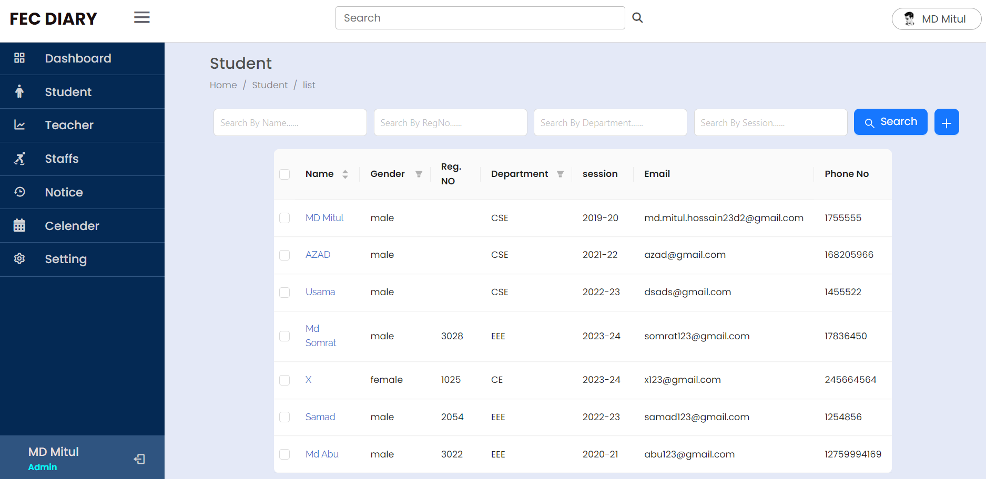
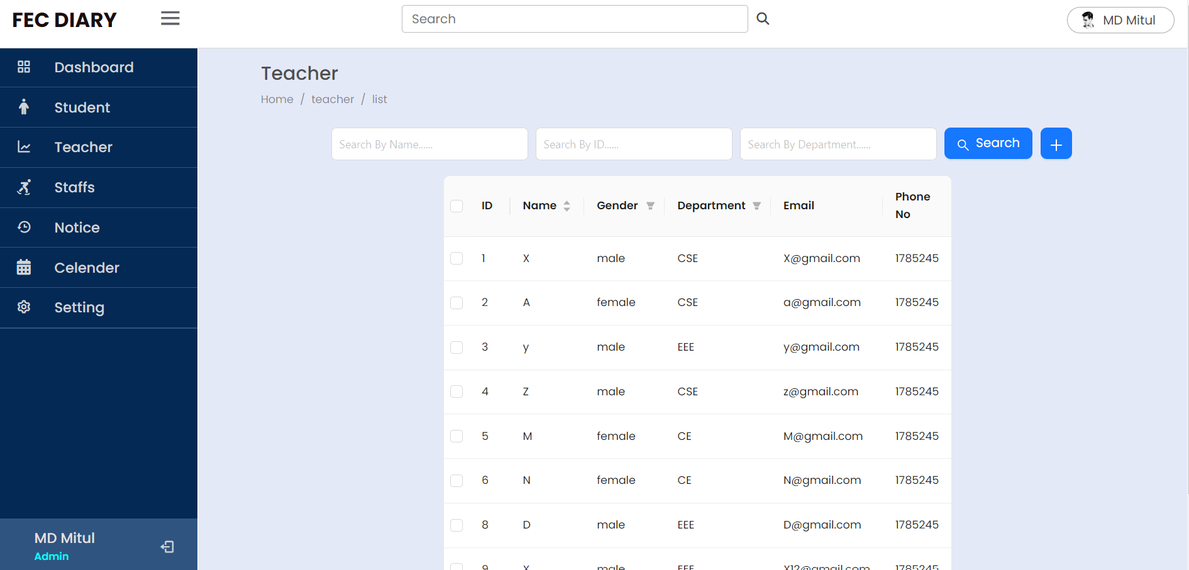
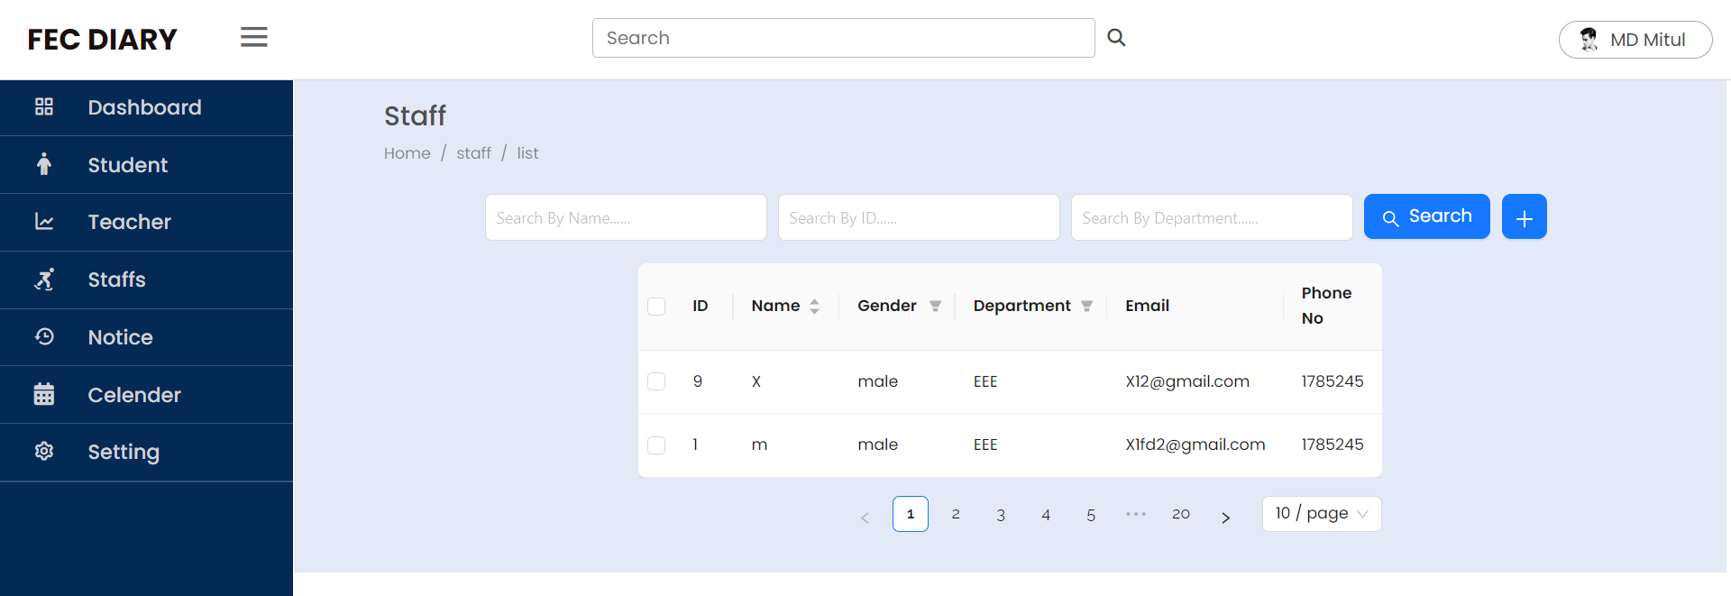
APPLICATION FEATURES(Cont..)
After Login
Student Table
Teacher Table
Staff Table

Slide 10
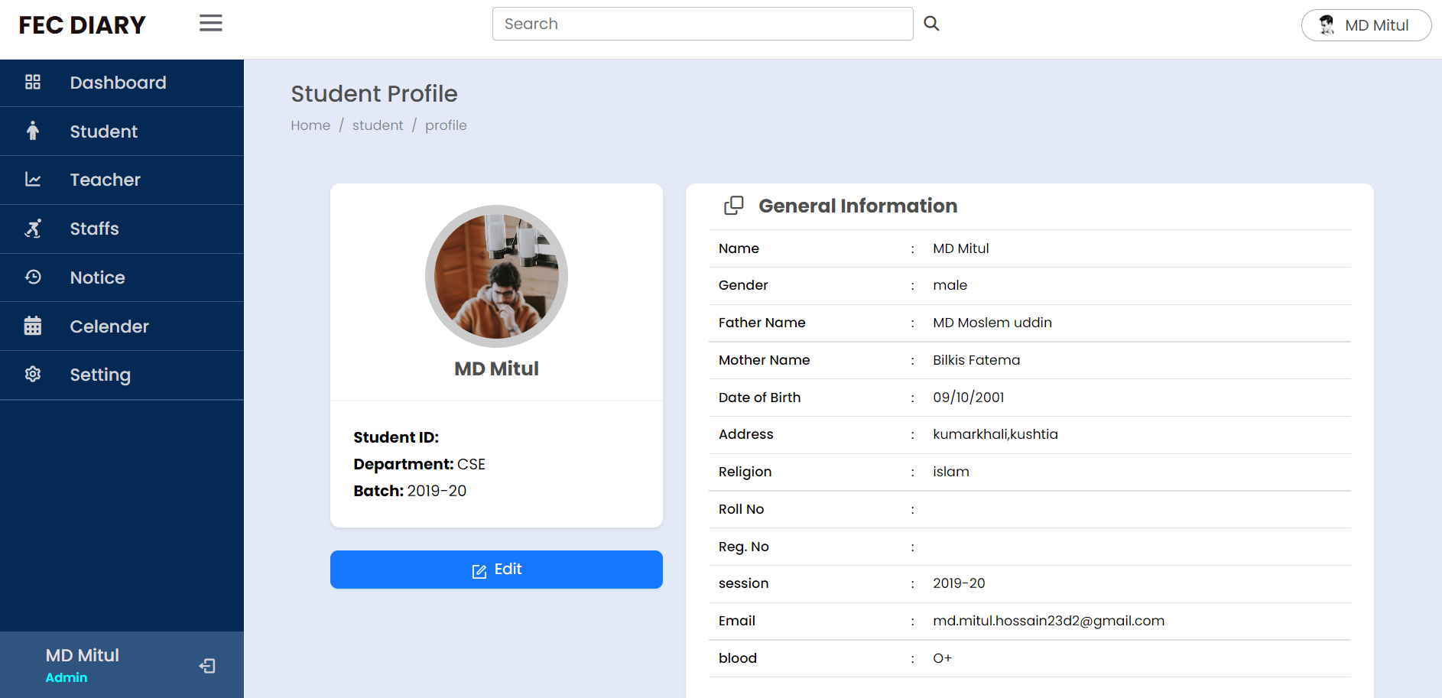
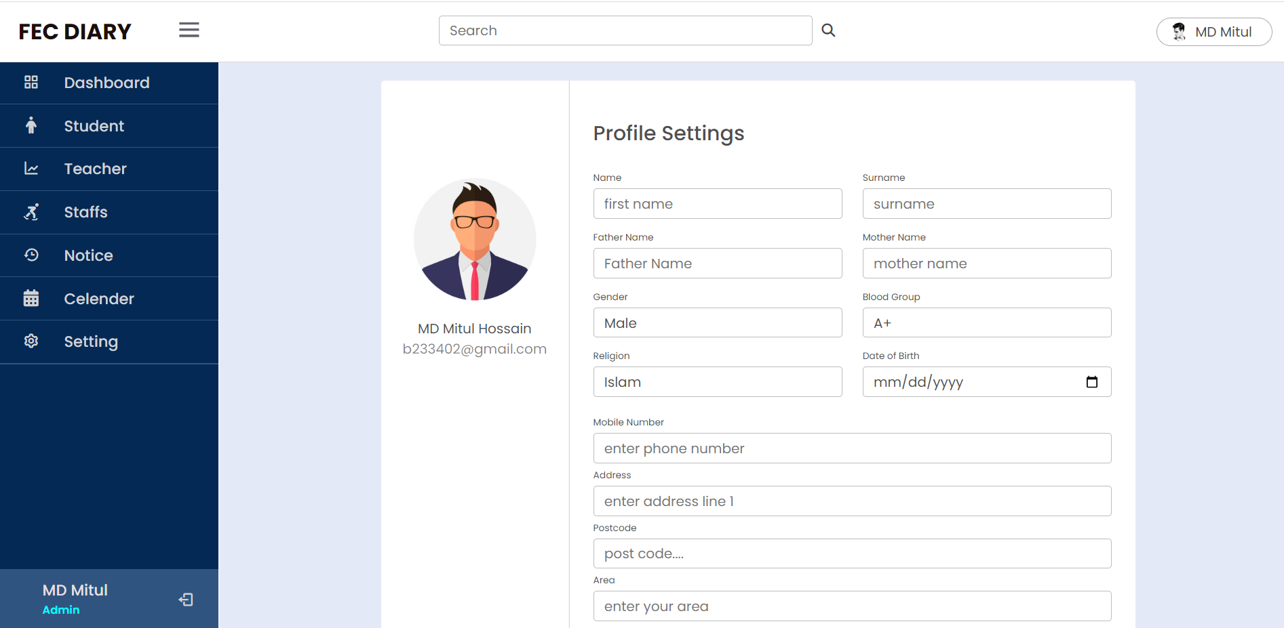
APPLICATION FEATURES(Cont..)
Student Profile
Profile Setting

Slide 11
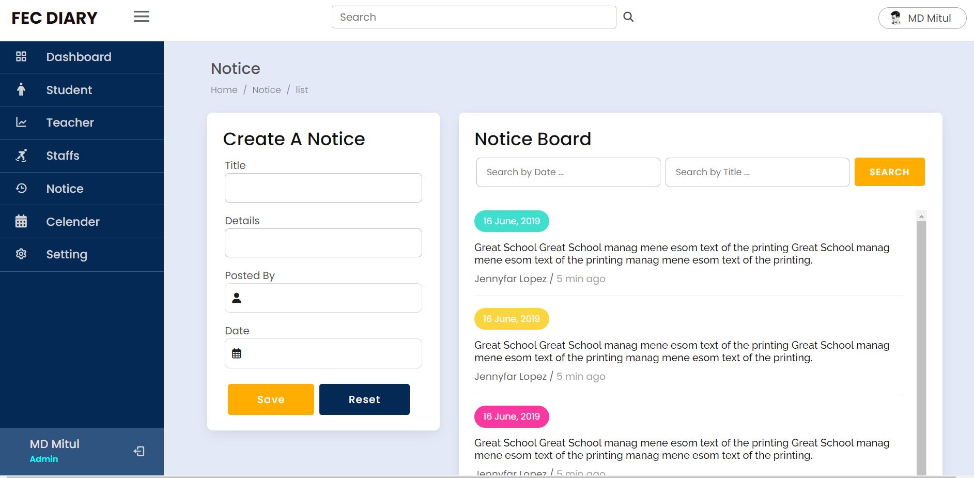
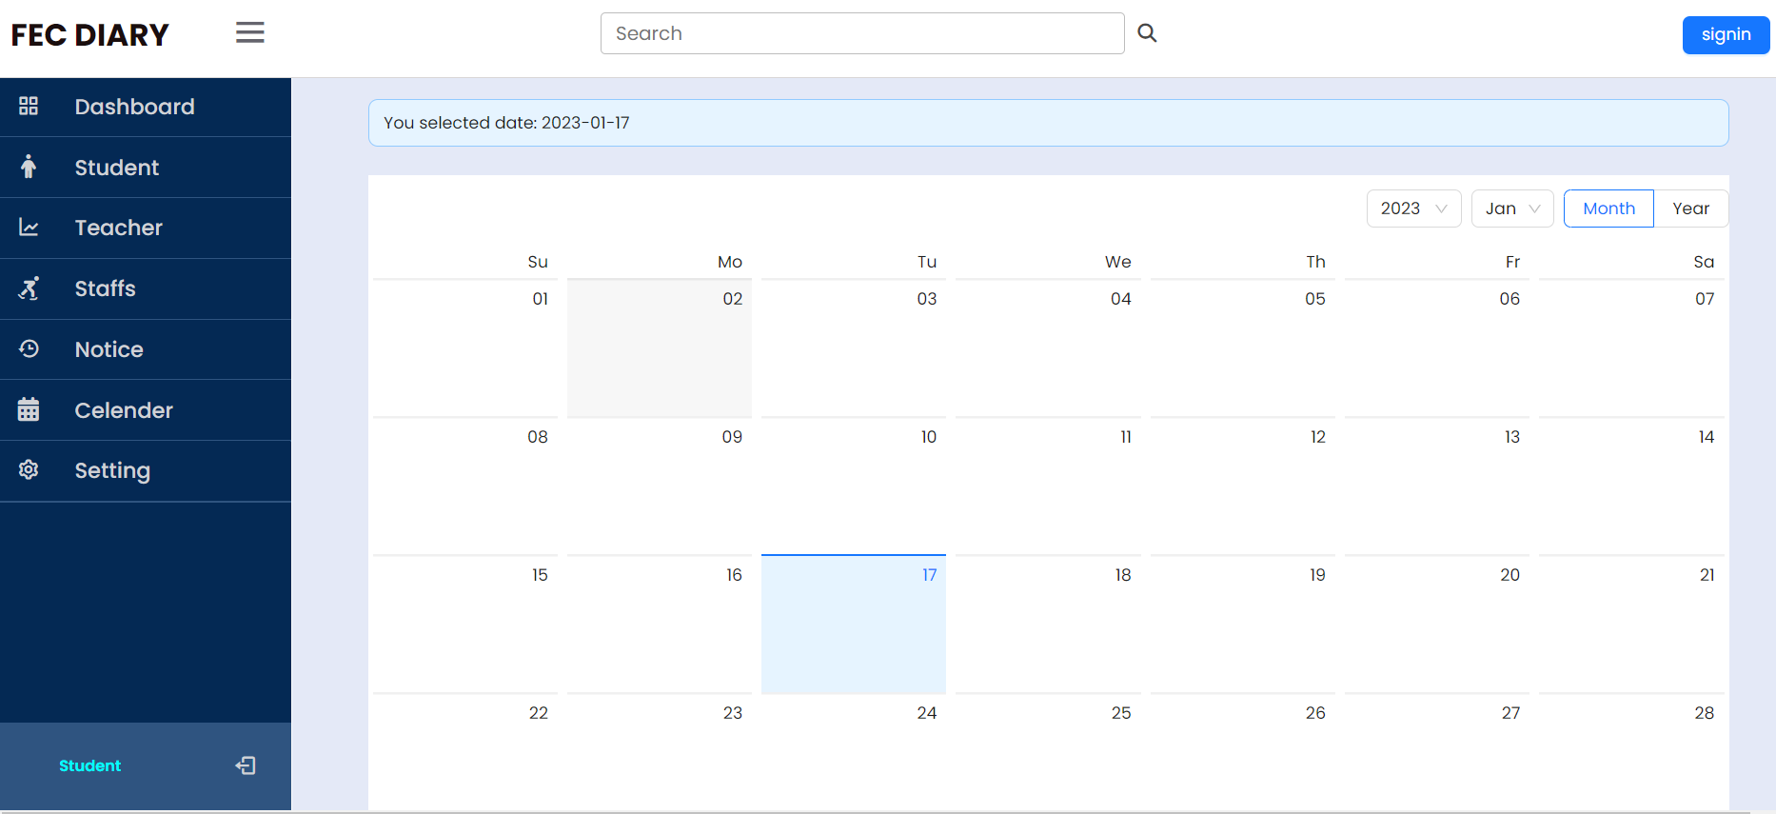
APPLICATION FEATURES(Cont..)
Notice Page
Academic Calendar

Slide 12
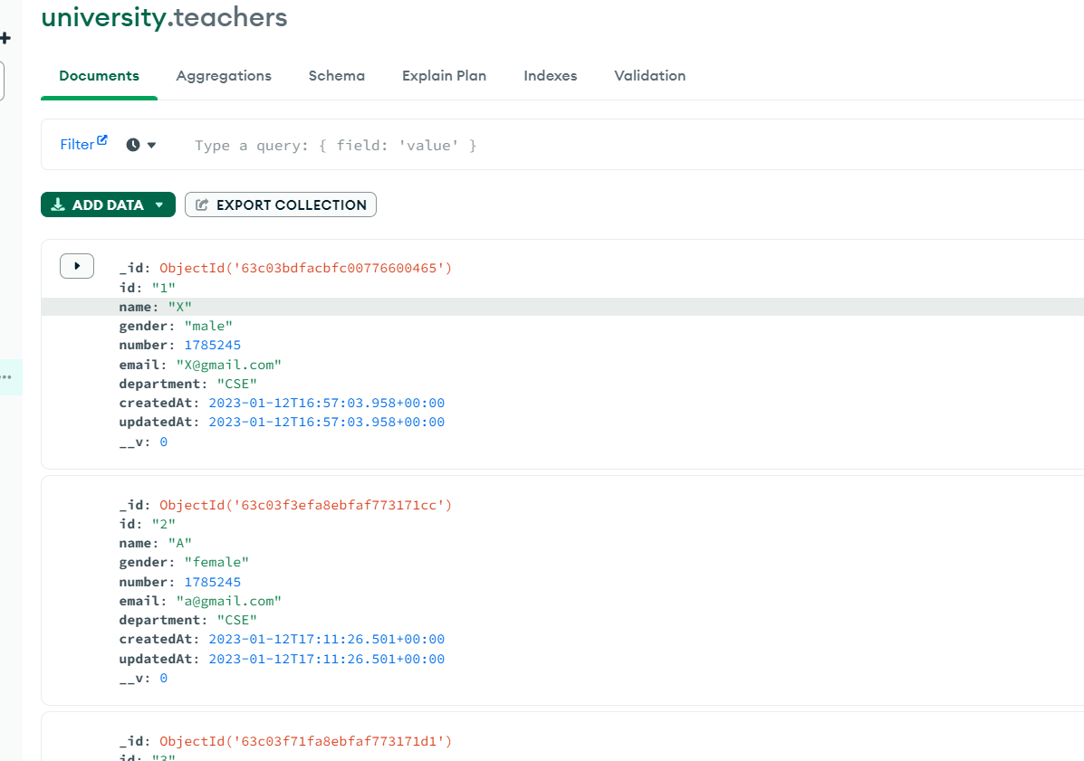
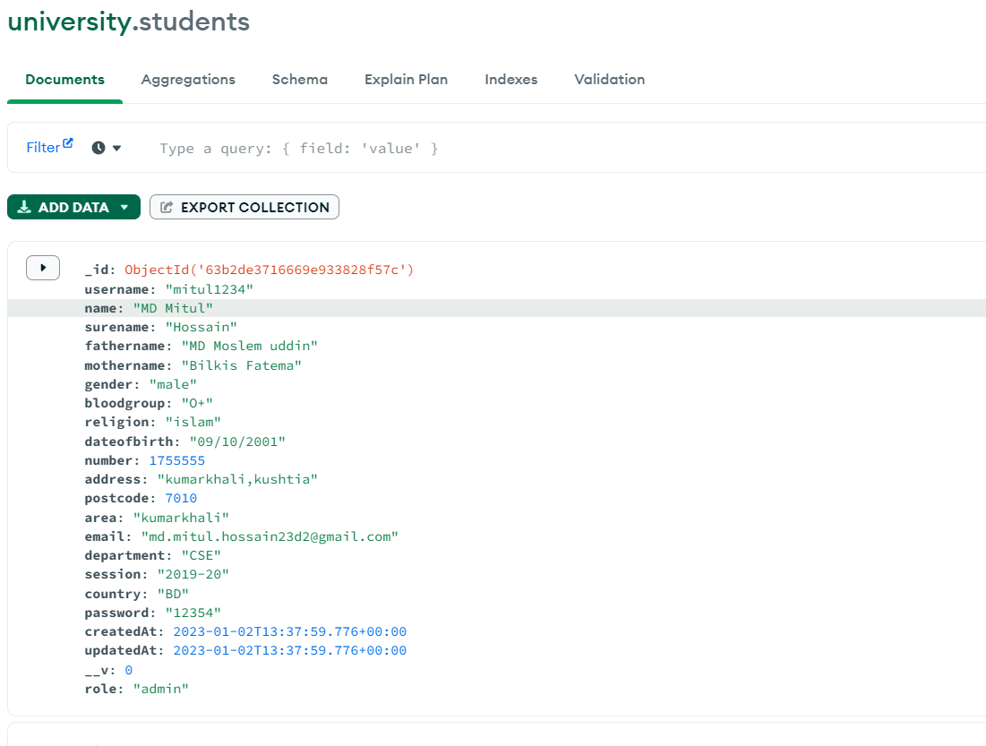
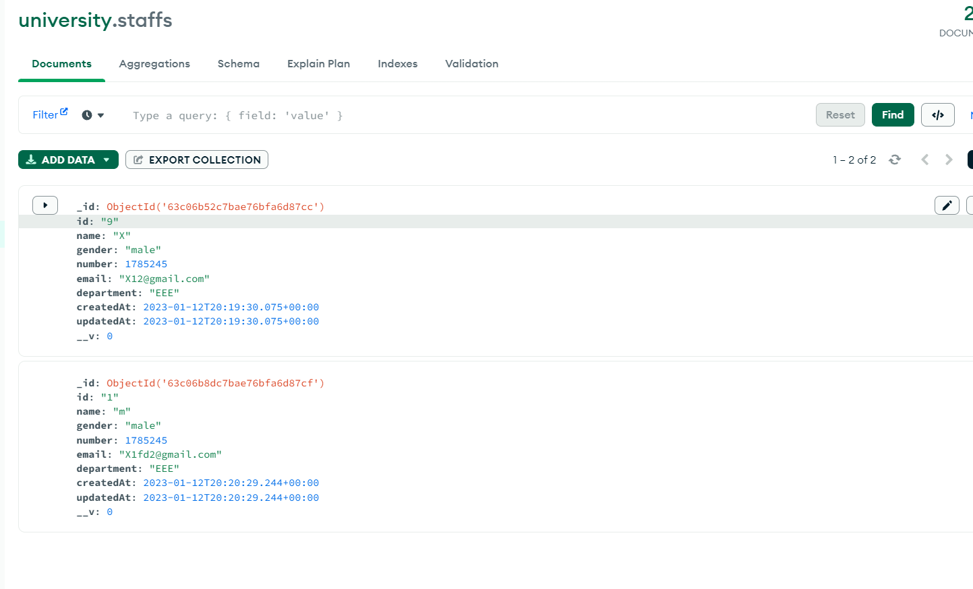
APPLICATION FEATURES(Cont..)
Teacher Data Table
Student Data Table
Staff Data Table

Slide 13
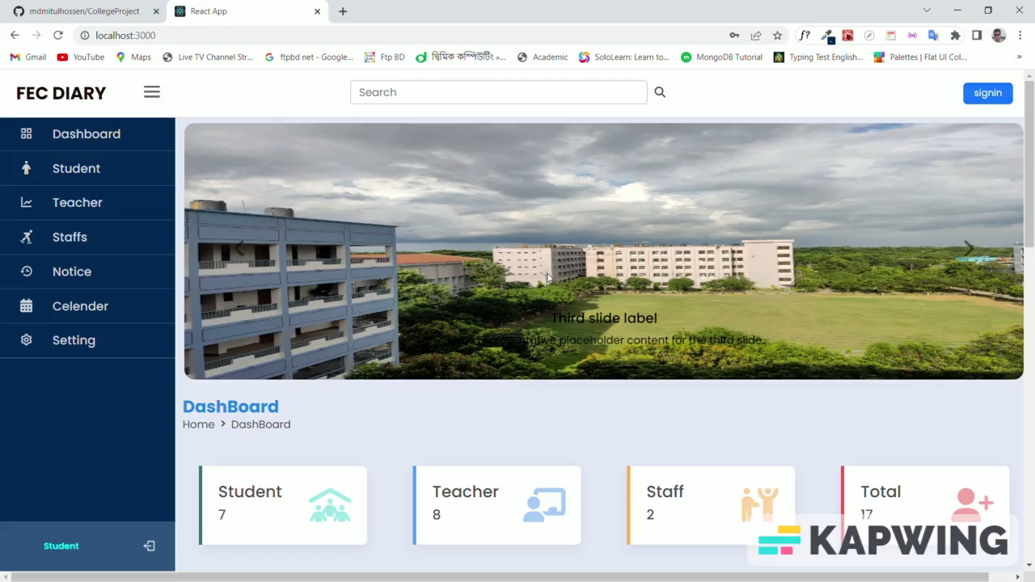
Project View

Slide 14
Future Work
Provide class routine
Student result management

Slide 15
Working TimeLine
1st December
^{10th} January
1st November
collecting student teacher staff information
CRUD Operation
Idea Presentation
Design Login,
Register Page
All Table Create.
^{15th} November
^{20th} December
Dashboard design
Authentication Apply[MongoDB]
www.free-powerpoint-templates-design.com

Slide 16
REFERENCES
https://themeforest.net/ For taking design ideas.
https://fontawesome.com/ Icons from here.
https://fonts.google.com/ Font from here.
https://getbootstrap.com/ For responsive webpage
https://www.w3schools.com/

Slide 17
Thank You

